Slide 1

ADVANCED POWER THEFT DETECTION SYSTEM
Project Work done in partial fulfilment of the requirement for the degree of
Bachelor of Engineering in Electronics and Communication Engineering
B.Godwin
Reg. No.963320106049
I.Azeer Lal
Reg. No.963320106027
C.M.Kabilesh
Reg. No.963320106061
A.Anton Nekesh
Reg. No.963320106020
Under the Guidance of
Dr. M.Reji
Associate Professor/ECE
Department of Electronics and Communication Engineering
ROHINI College of Engineering & Technology
Kanyakumari Main Road, Palkulam, Anjugramam – 629 401
April 2024

Slide 2

ABSTRACT
1
The Advanced Power Theft Detection System (APTD) presents an innovative solution for combating unauthorized power consumption within electrical systems.
In operation, the Advanced Power Theft Detection System utilizes two ESP8266 modules, designated as the primary and secondary nodes. The primary node continuously monitors current flow within the electrical circuit using a current sensor, while the secondary node serves as a baseline comparison
The parameter like voltage and current of the Advanced Power Theft Detection are done and monitor the energy consumption, thereby mitigating financial losses, enhancing system reliability, and promoting equitable access to electricity resources.
Advanced Power Theft Detection

Slide 3
OVERVIEW
2
Introduction
Objectives
Literature Survey
Existing System
Proposed System
Block Diagram
Components
Features
Application
Parameters
Output and Result
Conclusion
Reference
Thank You
Advanced Power Theft Detection

Slide 4
INTRODUCTION
3
Electricity theft is a very common problem, especially in our country.
As our population is high so the use of electricity is tremendously high.
There are many operational losses involve in the generation, transmission, and distribution of electrical energy.
Advanced Power Theft Detection

Slide 5
OBJECTIVES
4
Detect Electricity Theft
Rigorous Testing and Evaluation
Develop a system capable of detecting instances of electricity theft
Conduct thorough testing, including simulations and practical implementation
Real-Time Monitoring
Contribution to Efficiency and Reliability
Contribute to improving the overall efficiency and reliability of the electrical distribution network
Implement continuous monitoring of power consumption in real-time.
Advanced Power Theft Detection

Slide 6

LITERATURE SURVEY
5
TITLE OF THE PAPER WITH AUTHOR NAME
JOURNAL NAME/YEAR OF PUBLICATION
FINDINGS
LIMITATIONS
Title: A Literature Survey on Techniques of Power Theft Detection
Authors: Prof. Vaibhav Baburao Magdum and Prof. Ravindra Mukund Malkar
International Advanced Research Journal in Science, Engineering and Technology, Vol. 7, Issue 12, December 2020
Various methodologies including Support Vector Machine (SVM), Fuzzy C-means Clustering, and genetic algorithms have been explored for electricity theft detection.
Integration of smart meters and advanced algorithms offers potential solutions to minimize non-technical losses in distribution networks.
Accuracy and infrastructure requirements pose challenges in implementing existing theft detection systems.
Techniques like SVM may suffer from accuracy issues, especially in classifying data accurately.
Title: Power Theft Detection System (Review Paper)
Authors: Papai Bhakta, Suman Debnath, Partha Debnath, Paramita Das, Suparna Pal
International Journal of Creative Research Thoughts (IJCRT), Volume 10, Issue 5, May 2022
Electricity theft, in various forms such as meter tampering and illegal connections, poses significant challenges to power utilities.
Traditional methods of detecting power theft are being replaced by modern technologies like microcontrollers and smart meters.
Detection of power theft using traditional methods relies heavily on manual operations, leading to inefficiencies and inaccuracies.
The installation and maintenance costs associated with implementing smart meters and advanced detection systems may pose financial challenges for power utilities.
Title: Power Theft Detection using GSM
Authors: Rekha R. Patil, Shwetha, Thrupthi, Vaishnavi S. Shetty, Sanjeevi Kumar P
International Journal of Engineering Research & Technology (IJERT) / 2019
The proposed system effectively detects and prevents electricity theft by using a combination of hardware components such as leaf switches, current transformers, microcontrollers, relays, LCD displays, and GSM modules.
The system offers real-time monitoring and notification capabilities, allowing authorities to take necessary action upon detecting theft attempts.
The paper does not extensively discuss the scalability of the proposed system, particularly in larger utility networks or urban areas with high electricity consumption.
The experimental setup and findings may not fully capture the real-world challenges and complexities associated with electricity theft detection in diverse environments.
Title: Review Paper on Power Theft Detection and Prevention
Authors: Prof. Rupali Shinde, Prof. Soniya Joshi, Vaibhav Rampure, Rajendra Wagh, Dinesh Potdar, Mohsin Jamadar
International Journal of Advance Research, Ideas and Innovation in Technology (IJARIIE), Volume 6, Issue 5, 2020
Various techniques and systems have been proposed for the detection and prevention of power theft, utilizing components such as IoT, Arduino, GSM, PIC Microcontroller, current sensors, and voltage sensors.
The reviewed systems aim to minimize the illegal use of electricity, reduce the chances of theft, and take appropriate actions in case of theft detection.
Some systems rely heavily on specific technologies like GSM or IoT, which may have limitations in terms of coverage, reliability, or compatibility with existing infrastructure.
Practical testing and validation of these systems in diverse environments, including urban, rural, and industrial settings, are essential to assess their effectiveness and address potential issues.
Advanced Power Theft Detection

Slide 7
6
EXISTING SYSTEM
In existing systems errors may occur due to less concentration. It requires Huge Man power .
The system monitoring work gets delayed due to external conditions. Due to this Manual operation there is a high wastage of Power.
Energy crisis is the main problem that our society faces. A relevant system control and monitor power usage is one of the solutions to this problem.
One approach which is today’s energy crisis that can be addressed through reduction of power usage in households.
Advanced Power Theft Detection

Slide 8
7
PROPOSED SYSTEM
Hardware Components
Notification System
The system integrates two ESP8266 modules and two current sensors.
The System sends the notification when the theft is done.
Blynk IoT Platform
Theft Load
The system utilizes the Blynk app for remote monitoring and control.
This enables to detect and respond to instances of unauthorized power consumption.
Advanced Power Theft Detection

Slide 9
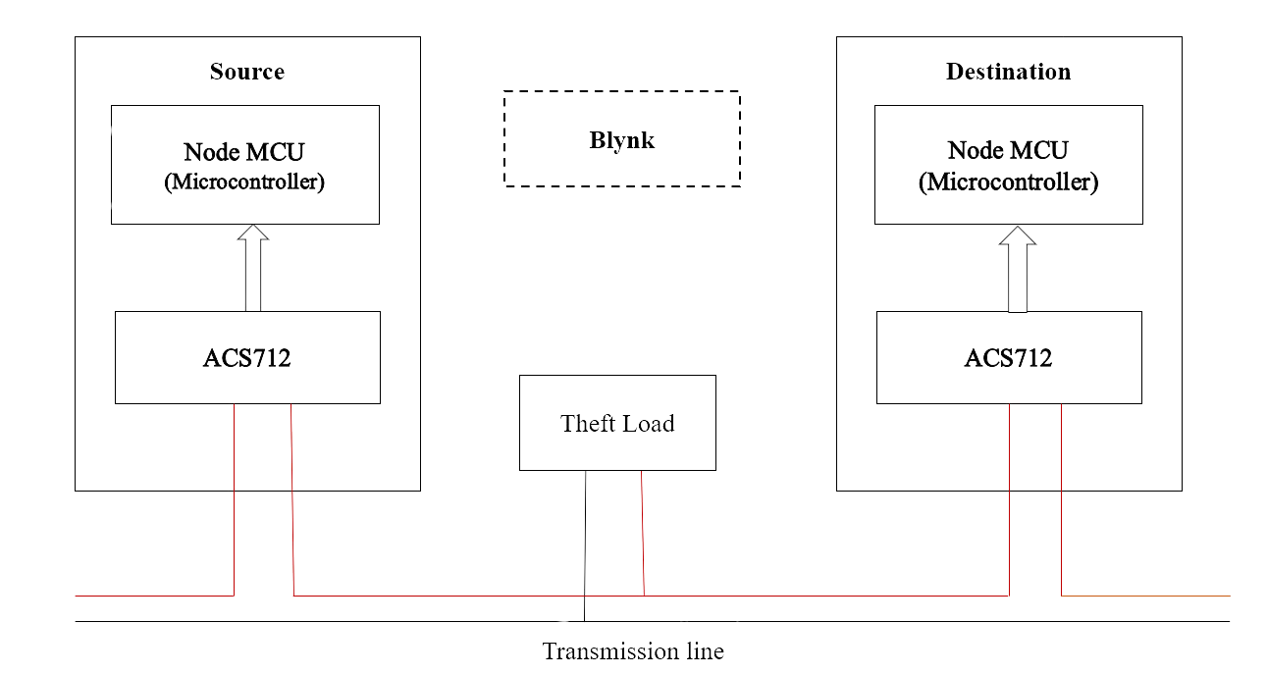
8
BLOCK DIAGRAM
Advanced Power Theft Detection

Slide 10
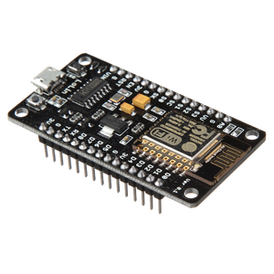
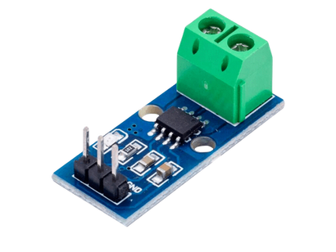
COMPONENTS
9
ESP8266
Current Sensors (ACS712)
The ESP8266 is a Wi-Fi module that enables wireless communication and data transmission.
The ACS712 is a Hall effect-based current sensor capable of measuring both AC and DC currents.
Blynk IoT Platform
Theft Load
Blynk is a popular IoT platform that allows users to control and monitor connected devices remotely through a mobile app.
This load is deliberately introduced to mimic scenarios where unauthorized devices or connections draw power from the distribution system.
Advanced Power Theft Detection

Slide 11
10
FEATURES
The system features:
Real-time monitoring of power consumption.
Anomaly detection for potential theft.
Integration with the Blynk IoT platform for remote access.
Alert notifications for prompt action.
Scalability for deployment across diverse networks.
Advanced Power Theft Detection

Slide 12
11
APPLICATION
Utility companies: Combat electricity theft, reduce revenue losses.
Government agencies: Enforce energy regulations, prevent illegal activities.
Smart cities: Ensure efficient, secure electricity distribution.
Industrial facilities: Optimize energy usage, minimize costs.
Residential/commercial buildings: Monitor electricity usage, detect inefficiencies.
Renewable energy projects: Ensure integrity, reliability of energy sources.
Advanced Power Theft Detection

Slide 13
12
PARAMETERS
HARDWARE DESCRIPTION
ESP8266
Current Sensor(ACS712)
Additional Load for detection
SOFTWARE DESCRIPTION
Arduino IDE
Blynk application
Pushbullet
Advanced Power Theft Detection

Slide 14
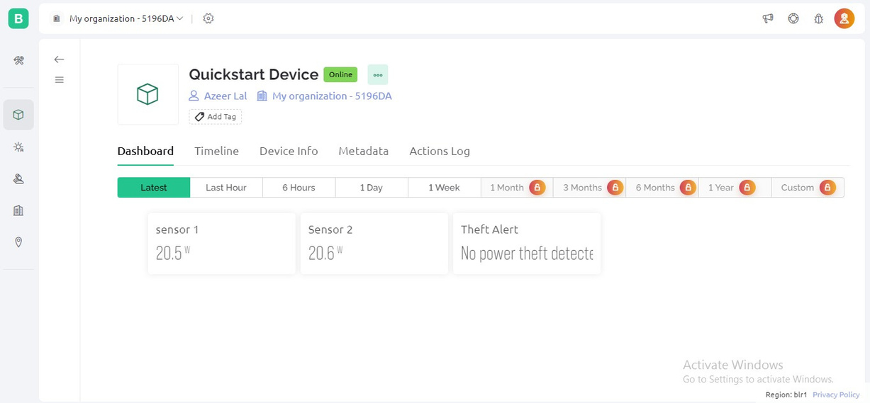

13
OUTPUT AND RESULT
The system accurately identifies irregularities in power consumption patterns, such as sudden spikes or drops, signaling potential electricity theft.
Advanced Power Theft Detection

Slide 15
14
CONCLUSION
This initiative is geared towards boosting IoT connectivity and networking within the realm of smart city evolution. We're deploying sensors to detect facility theft, pinpoint faults, and track the fault area for necessary actions. The proposed system addresses key challenges in India's current grid setup, such as energy wastage, power theft, and cable faults. Moreover, it helps curb factors prompting electricity theft, contributing to a more robust and accountable energy framework.
Advanced Power Theft Detection

Slide 16
15
REFERENCE
1]Ajay Mahato, A. N. (2018). Electric Power Theft Detection And Location Tracking Using IoT. International Journal of Scientific Research in Computer Science, Engineering and Information Technology(IJSRCSEIT) | Volume 4 | Issue 5 | ISSN : 2456-3307,
2]Guhesh Swaminathan, M. S. (n.d.). Distribution Line Monitoring System For The Detection Of Power Theft Using Power Line Communication.
3]N Kunan, P. B. (2017). IoT Based Power Theft Detection And Monitoring System (IJIREICE 2017). International Journal of Innovative Research in Electrical, Electronics, Instrumentation and Control Engineering ISO 3297:2007 Certified Vol. 5,
4] Karthikeya S, Bhuvaneswari P.T.V,"IoT Based Real-Time Residential Energy Meter Monitoring System",IEEE Trends in Industrial Measurement and Automation (TIMA),Electronic ISBN: 978-1-5090- 3001-9 ISBN: 978-1-5090-3002-6, (2017).
5] Harsha Khandel , Suchitra Pandey and D. Reynolds, “A Review on IOT Based Power Theft Detection and Control Systems”, International Journal of Innovative Research in Electrical, Electronics, Instrumentation and Control Engineering, Vol. 5, Issue 9, ISSN (Online) 2321 – 2004 ISSN (Print) 2321 – 5526 , (2017)..
Advanced Power Theft Detection

Slide 17
16
Mishra, P., Mishra, A., & Gupta, S. (2019). IoT-Based Power Theft Detection and Control System. International Journal of Advanced Research in Computer Engineering & Technology (IJARCET), 8(7), 467-472. [12]
Nath, D., & Dutta, S. (2020). IoT-Based Smart Energy Metering System for Power Theft Detection. IEEE Transactions on Industrial Informatics, 16(9), 5577-5586. [13]
Patel, H., Patel, P., & Patel, K. (2018). Smart Metering and Power Theft Detection Techniques Using IoT. International Journal of Innovative Research in Computer and Communication Engineering, 6(6), 9485-9491. [14]
Qureshi, M. A., & Khan, F. (2019). IoT-Based Power Theft Detection and Control System. International Journal of Electrical, Electronics and Computer Systems, 8(5), 15-21. [15]
Rahman, M. A., Islam, M. S., & Hasan, M. R. (2017). Smart Grid with Power Theft Detection Using IoT and Blockchain Technology. IEEE Transactions on Smart Grid, 6(3), 1259-1268. [16]
Singh, R., Kaur, A., & Kumar, P. (2020). Power Theft Detection and Control Using IoT and Machine Learning. International Journal of Scientific & Engineering Research, 11(6), 980-985. [17]
Tripathi, S., Yadav, R., & Tiwari, S. (2021). IoT-Based Smart Power Theft Detection System Using Machine Learning. IEEE Transactions on Industrial Informatics, 17(8), 5648-5656
Advanced Power Theft Detection

Slide 18
THANK YOU
Advanced Power Theft Detection

